Slide 1
Physics!

Slide 2
5 min - Warm-Up Question!
If there is a string with a scale in the center of it, and two people are each pulling with 20 lbs of force on each end of the string, what force does the scale register?
0 lbs
20 lbs
40 lbs
400 lbs
Notes:
Answer → b) 20 lbs
alex

Slide 3
Agenda
10 min — warm-up question + explanation
15 min — forces
15 min — paper plane activity
15 min — basics of aviation
10 min — moment
Notes:
agastya

Slide 4
Forces
Notes:
maya

Slide 5
Statics
Assessing a non-moving situation for maximum forces it can take before breaking
Notes:
maya

Slide 6
Newton’s Three Laws
An object in motion stays in motion unless a force acts upon it + inertia (more mass = harder to move)
Force = mass * acceleration or f=ma
Every action has an equal and opposite reaction.
Notes:
maya

Slide 7
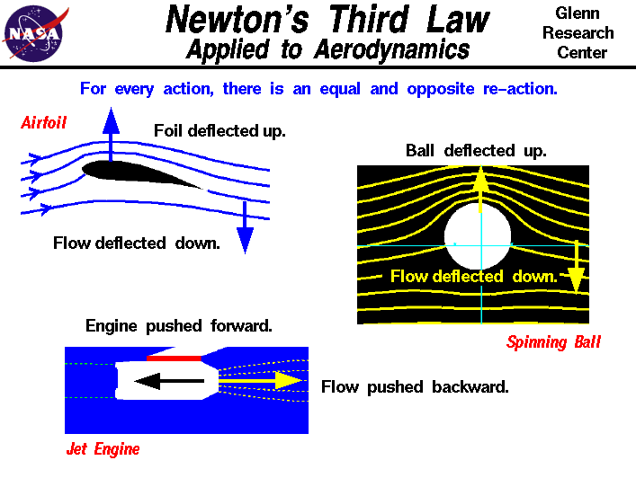
Newton + False lift theory
Newton’s 3rd law
Semi-false theory: lift is generated because air that goes under the wing is pushed down, which pushes the wing up
Notes:
alex

Slide 8
And now time for Jeff!
https://www.youtube.com/watch?v=5aHaf0KlT9s
* go to 9:15
Notes:
alex

Slide 9
Scalar — a number
Vector — a number with a direction
A force is represented by a vector
Magnitude = length of the vector
V
y
x
Notes:
agastya

Slide 10
Solve this!
What is the total force on the longeron (blue-green arrow)?
Hint:
Pythagorean theorem:
a² + b² = c²
150 lbf
1000 lbf
Notes:
agastya

Slide 11
Moment
Notes:
maya

Slide 12
Try this!
Get something heavy (a book, a chair, a water bottle, etc) and hold it close to you. Now try holding it far away. Is it harder to carry when you’re holding it away from you?
Notes:
maya

Slide 13
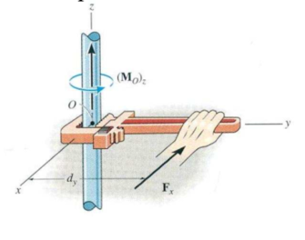
What is a moment?
A force * a distance makes a rotational moment.
Units: distance times force, ie (lbf*f, or pound feet)
If you move your hand closer to the center it will be harder to spin the rod
Notes:
alex

Slide 14
Small forces at large distance can HEAVILY affect the plane
Notes:
alex

Slide 15
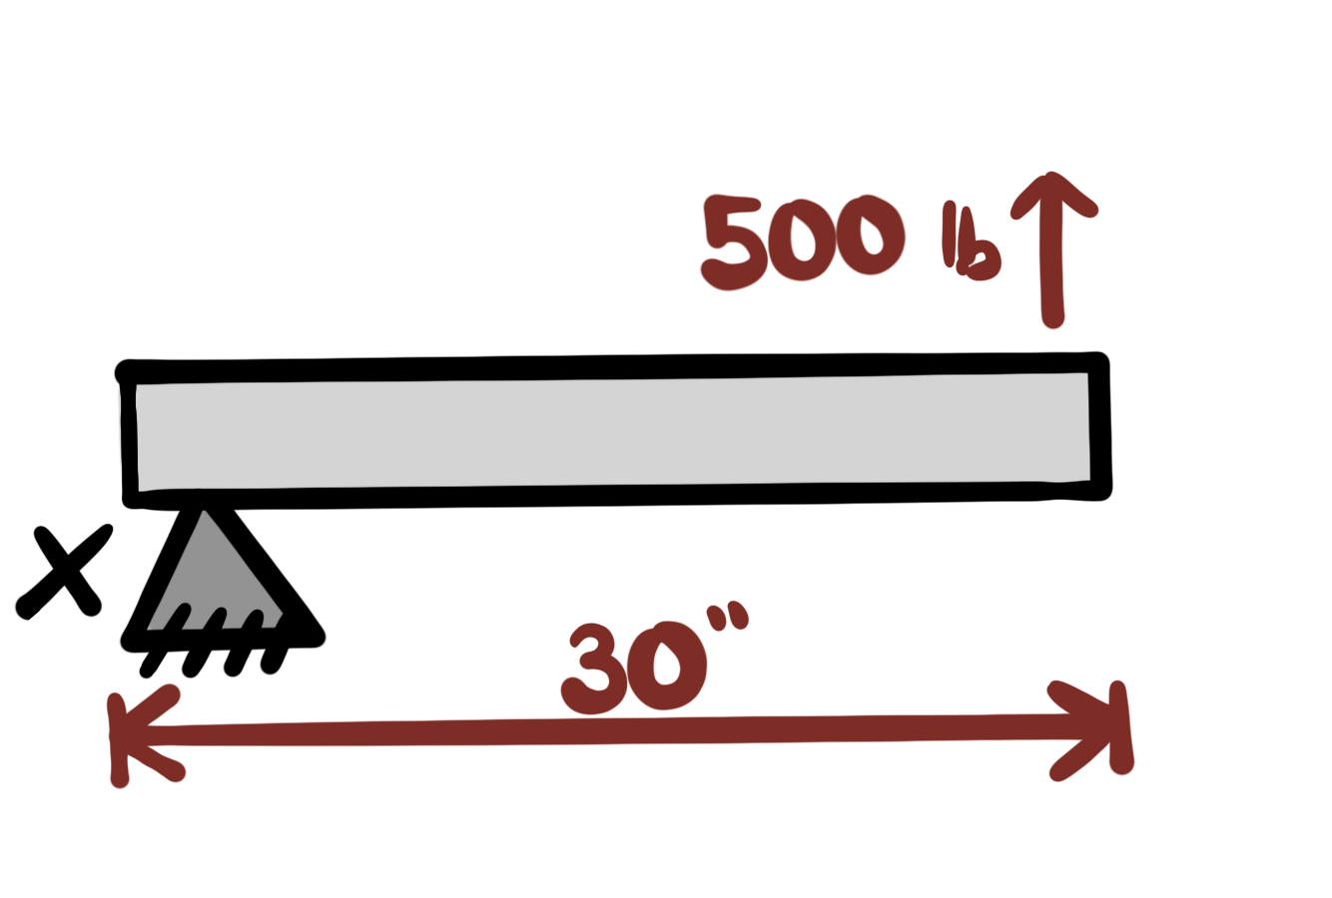
Question!
What is the moment around point x in lbi? (assuming the tube is static)
What direction will it turn? (if the tube is not static)
Notes:
agastya

Slide 16
Answer:
15000 pound inches, counterclockwise
Notes:
agastya

Slide 17
Why this matters
All moments balance around center of gravity
For example, try balancing a pencil on your finger, where it perfectly balances is around where the CG is.
A small amount of force on the tail (far from CG) has a big impact
Notes:
maya

Slide 18
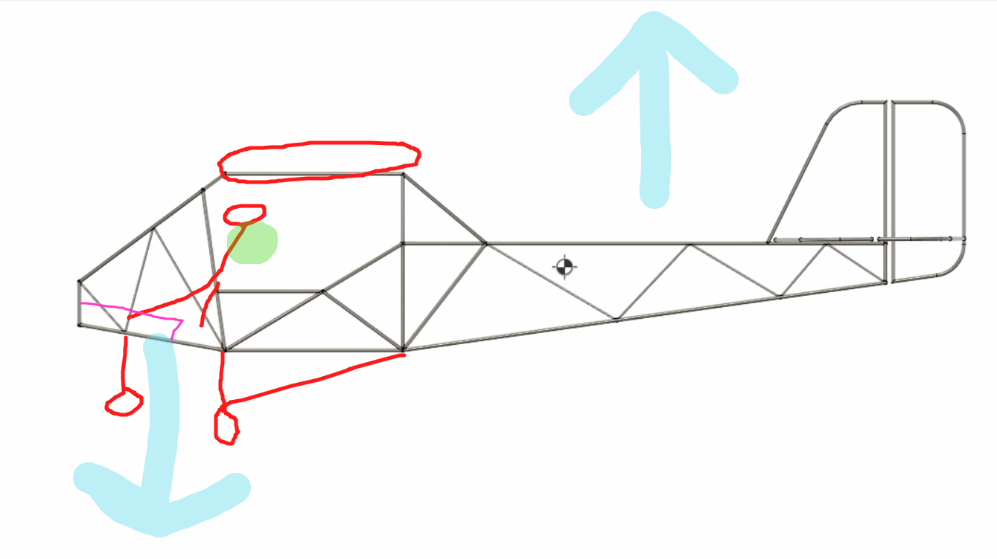
Weight is balanced on green point
Notes:
maya

Slide 19
10 mins — Activity!
Make this plane: https://www.foldnfly.com/1.html
Record flight properties
Make this one: https://www.foldnfly.com/13.html#The-UFO
Record observations - differences? Similarities?
Notes:
alex

Slide 20
What did you observe?
Which flew longer?
Best glide ratio?
(glide ratio - how far you go forward vs down)
Which flew farther?
Plane 1:
Plane 2:
Notes:
Maya Note to presenters: be ready to explain their observations →
Farthest
Slowest
Best glide ratio

